Slide 1


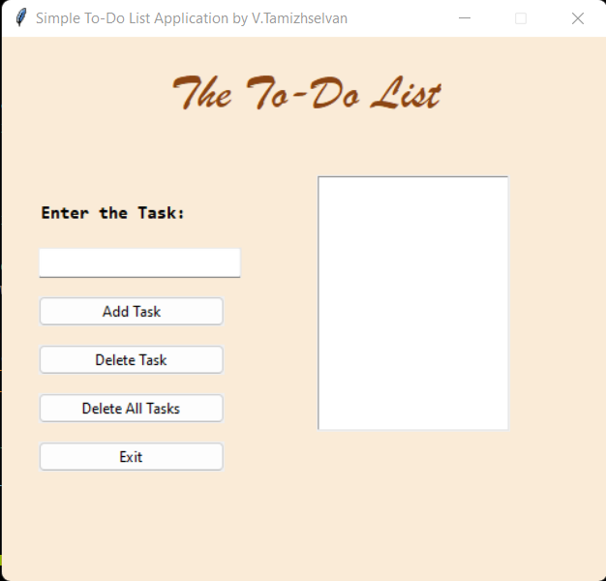
CSA0883 – Python Programming for Data Visualization
Smart Simple To-Do List Application Using Python
Project By,
Tamizhselvan.V
192224029
Bachelor’s of Technology (Artificial Intelligence and Data Science)
SIMATS, Saveetha School of Engineering
Guided By,
Dr. E.K.Subramanian
(Course faculty)
Python Programming SIMATS, Saveetha School of Engineering

Slide 2
TABLE OF CONTENTS
Abstract
Introduction
Implementation of a Simple Todo List Application in Python
Advantages and Disadvantages of a Simple To-Do List Application in Python
Key functionalities
Code Sniffets
Output
Future scopes of a Simple to-do list application developed using Python
Conclusion
Bibliography

Slide 3
Abstract
This project involves developing a simple yet functional Todo List application using Python programming.
The application aims to provide users with an intuitive interface to manage their daily tasks effectively.
By leveraging Python's versatile libraries and modules, the application offers features such as task creation, deletion, and categorization, along with the ability to set deadlines and priorities.
The design of the Todo List application focuses on ease of use and efficiency.
It employs a graphical user interface (GUI) built with Tkinter, a standard Python library for creating GUI applications.
Users can add new tasks, mark tasks as completed, delete tasks, and filter tasks based on their status or priority.
The application also integrates with a local database (using SQLite) to persistently store user data, ensuring that task information is not lost between sessions.
By developing this Todo List application, the project aims to enhance users' productivity and organization skills, providing a practical tool for everyday task management.
Additionally, it demonstrates the capability of Python in developing desktop applications, highlighting the language's simplicity and effectiveness in handling common software development tasks.

Slide 4
Introduction
In today's fast-paced world, staying organized and managing tasks efficiently is crucial.
A simple Todo list application serves as an essential tool for individuals to keep track of their tasks, set priorities, and enhance productivity.
This introduction aims to elaborate on the development of a basic Todo list application using Python, a versatile and powerful programming language.
Python's simplicity and readability make it an excellent choice for beginners and experienced developers alike.
It provides a wide range of libraries and frameworks that facilitate rapid application development.
For this Todo list application, we will leverage Python's fundamental data structures and functionalities to create a user-friendly and efficient task management system.
Developing a simple Todo list application in Python is an excellent way to enhance your programming skills while creating a practical tool for everyday use.
This project will provide hands-on experience with Python's core features and demonstrate the power and flexibility of the language.
Whether you are a beginner looking to learn Python or an experienced developer seeking to build a useful application, this project is an ideal starting point.

Slide 5
Implementation of a Simple To-do List Application in Python
Requirements:-
1. Python 3.x
2. Basic knowledge of file handling
3. Understanding of lists and dictionaries
The implementation of the Todo list application will involve the following steps:-
1. Setting Up the Environment: Install Python and any necessary libraries.
2. Designing the Data Structures: Use lists and dictionaries to store tasks and their attributes.
3. Implementing Core Features: Write functions to add, delete, and view tasks.
4. File Handling: Implement file operations to save and load tasks.
5. User Interface: Develop a simple command-line interface for user interaction.

Slide 6
Advantages and Disadvantages of a Simple To-Do List Application in Python
Advantages:-
Ease of Learning and Use
Wide Range of Libraries
Cross-Platform
Community Support
Flexibility
Readable Code
Disadvantages:-
Scalability
Performance Limitations
Mobile Development
Global Interpreter Lock (GIL)
Dependency Management
Runtime Errors

Slide 7
Key functionalities
1. Task Management: Users can create, update, and delete tasks. Each task can have a description, due date, and priority level.
2. Task Categorization: Tasks can be categorized into different groups, allowing users to organize their tasks based on projects or personal preference.
3. Search and Filter: Users can search for tasks and filter them based on criteria such as due date, priority, or completion status.
4. Data Persistence: The application uses SQLite to store tasks, ensuring data is saved between sessions and can be retrieved anytime.
5. User-Friendly Interface: The application provides an intuitive and visually appealing interface, making it easy for users of all ages to interact with.

Slide 8
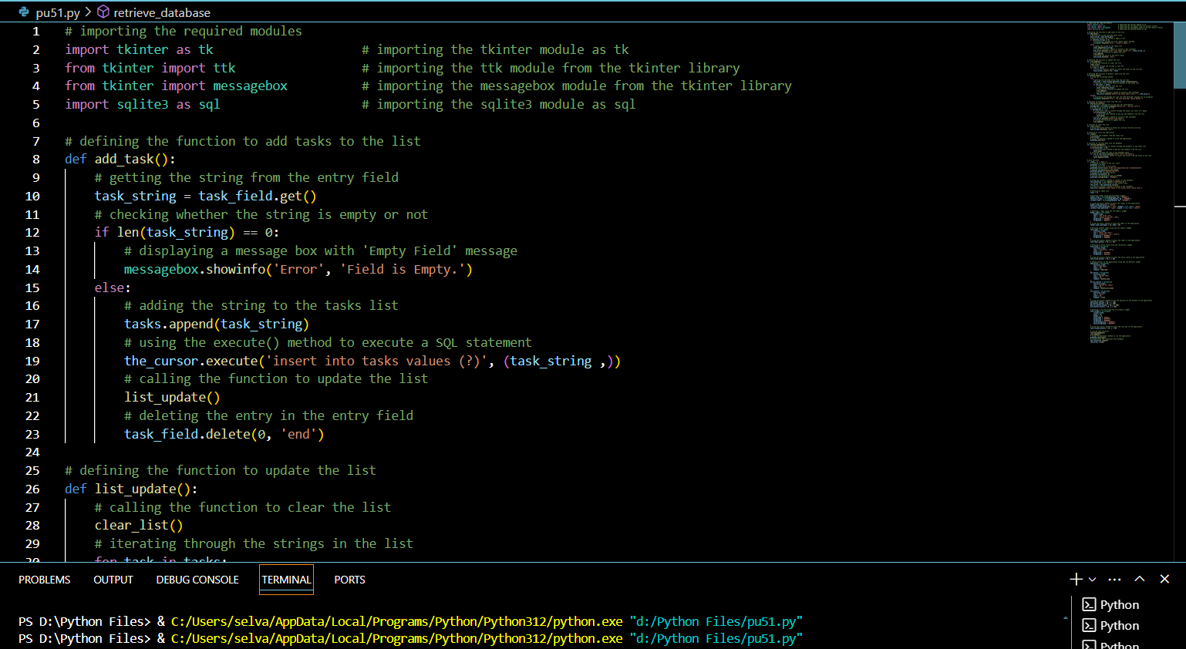
Code Sniffets

Slide 9
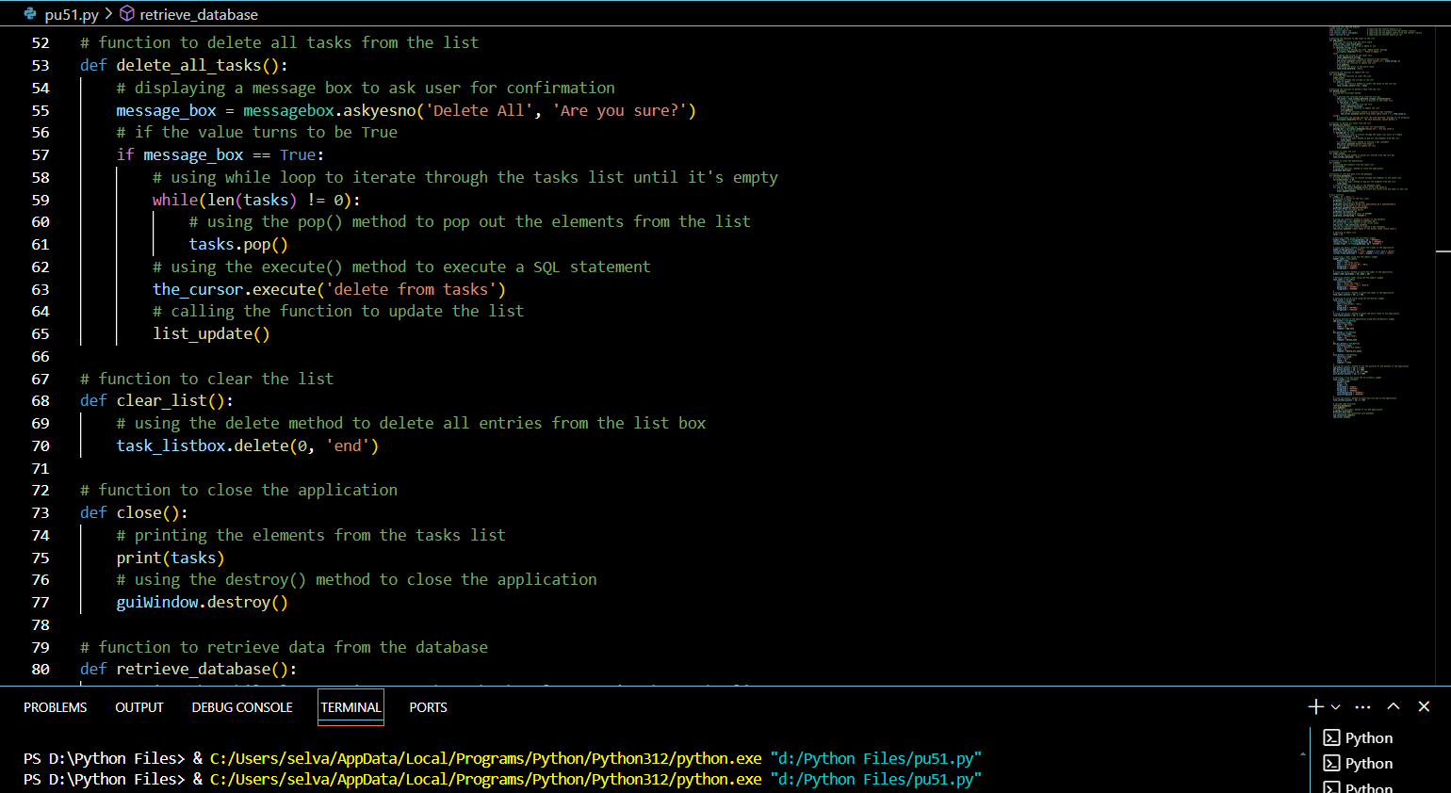
Code Sniffets

Slide 10
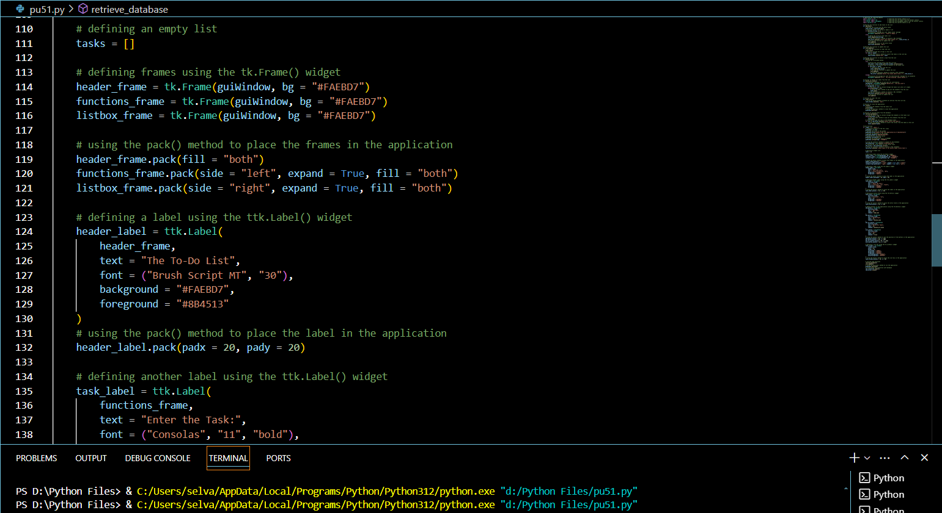
Code Sniffets

Slide 11
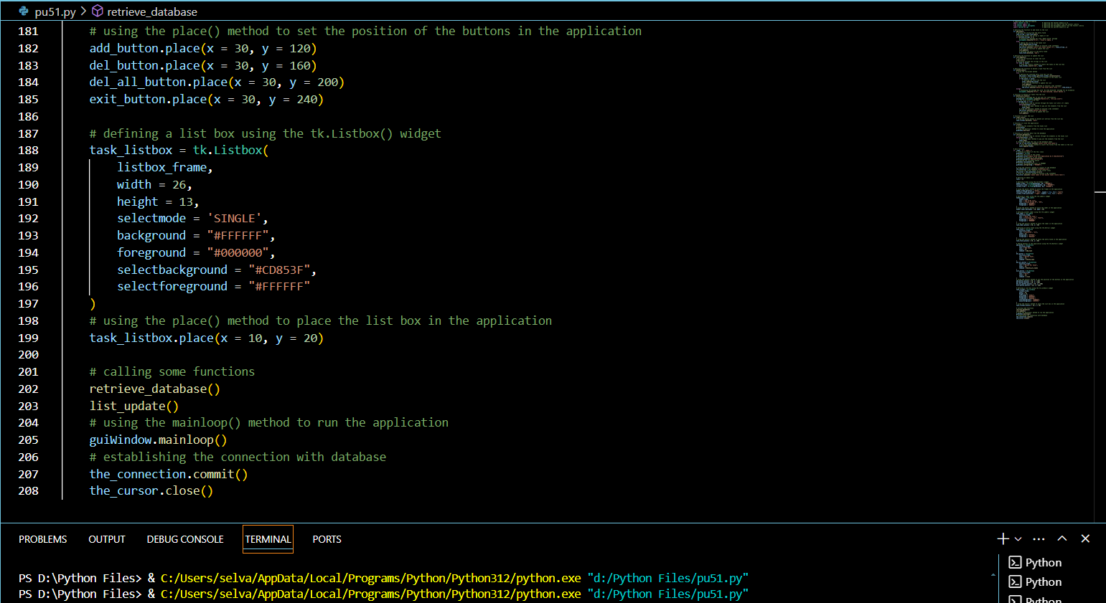
Code Sniffets

Slide 12
Output

Slide 13
Future scopes of a Simple to-do list application developed using Python
1. User Authentication and Profiles: Implement user registration and login functionality.
2. Cloud Synchronization: Integrate cloud services to sync tasks across multiple devices.
3. Collaboration Features: Enable sharing of to-do lists with other users.
4. Advanced Task Management: Add features for task categorization, tagging, and prioritization.
5. Natural Language Processing (NLP): Use NLP to allow users to add tasks using natural language (e.g., "Meet John for lunch at 2 PM tomorrow").
6. Integration with Other Tools: Integrate with calendars (Google Calendar, Outlook) to auto-schedule tasks.
7. AI and Machine Learning: Use machine learning algorithms to predict task completion times and suggest optimal schedules.
8. Mobile and Web Applications: Develop mobile applications for iOS and Android using frameworks like Kivy or BeeWare.
9. Data Analytics: Provide users with insights and analytics on their productivity.
10. Customization and Themes: Allow users to customize the UI with different themes and layouts.

Slide 14
Conclusion
The development of a simple Todo List application using Python has demonstrated the practicality and efficiency of using a high-level programming language to manage everyday tasks. This project underscores several important aspects of software development, including:-
User-Friendly Design
Fundamental Programming Concepts
3. Problem-Solving Skills
4. Code Modularity and Reusability
5. Practical Application of Python

Slide 15
Bibliography
[Python Lists](https://docs.python.org/3/tutorial/datastructures.html#more-on-lists)
[Python Dictionaries](https://docs.python.org/3/tutorial/datastructures.html#dictionaries)
[Real Python: Building a Simple To-Do List with Python](https://realpython.com/python-project-for-beginners/#building-a-simple-to-do-list)
[GeeksforGeeks: To-Do List Application in Python](https://www.geeksforgeeks.org/to-do-list-application-using-tkinter/)
"Automate the Boring Stuff with Python" by Al Sweigart: This book has a project that involves creating a simple command-line Todo list.
"Python Crash Course" by Eric Matthes: This book covers basic Python projects, including a simple Todo list.
[Simple To-Do List App](https://github.com/davidtavarez/simple-todo-list) - A basic implementation of a Todo list in Python.
[Python Todo List](https://github.com/susan-sharma/Python-To-Do-List) - Another example of a Todo list application using Python and Tkinter.

